Slide 1






Lecture 4:
Styling DOM Elements
Course - Web Development - II
-By
Instructor Name
welcome@krmangalam.edu.in
Sohna Road,Gurugram,Haryana 122103

Slide 2

| Table of Contents
style property
classList add/remove/toggle
References.
The End.

Slide 3

|
Now imagine you've found the person in the room. What if you want them to say something different? Or wear a different color jacket?

Slide 4

|
Now imagine you've found the person in the room. What if you want them to say something different? Or wear a different color jacket?
So after we select the element, the next step is to control what it says or how it looks — and that’s exactly what we’ll learn in: Changing Content & Styles.
If you want them to say something else, you change their message — like using .textContent or .innerHTML.
If you want them to look different, you change their appearance — like using .style or .classList.

Slide 5

| Changing Content & Styles
Changing Content & Styles means using JavaScript to update what an element says (like text or HTML) and how it looks (like color, size, or layout) on the page.
Think of it like:
“JavaScript is saying: Okay, now that I’ve found it — what should I make it say or how
should it look?”

Slide 6
| Changing Content & Styles
JavaScript gives us built-in properties and methods to change the content and appearance of elements on the page.
You use these after selecting an element, depending on whether you want to update text, HTML, or CSS styles.
To Change Content:
.innerText
.innerHTML
.textContent
To Change Styles:
.style

Slide 7
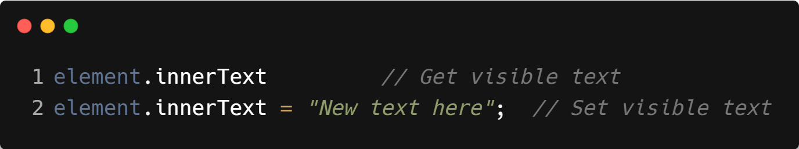
| .innerText
.innerText is a property in JavaScript that allows you to get or change only the visible text inside an HTML element.
It ignores hidden content (like elements styled with display: none or visibility: hidden), and respects line breaks and spacing as seen by the user.
Syntax :

Slide 8
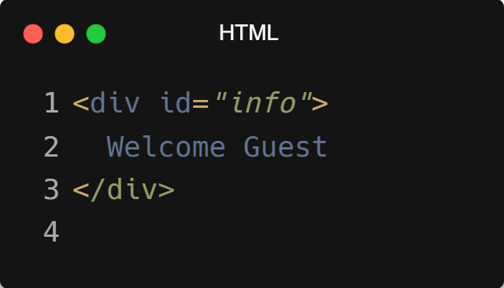
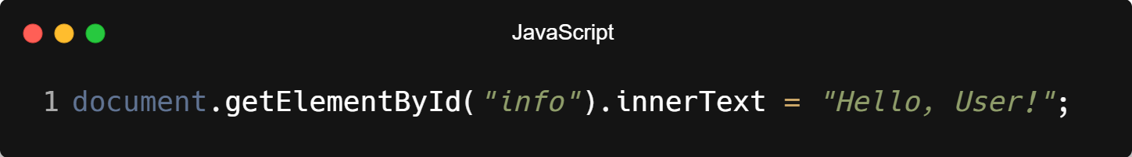
| .innerText
Example :

Slide 9


| .innerText
Output:
Before Adding .innerText
After Adding .innerText

Slide 10
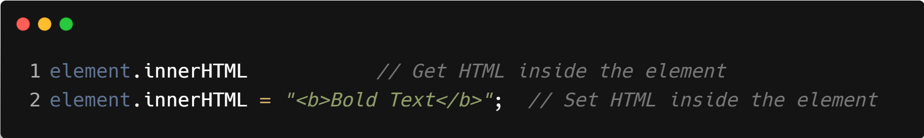
| .innerHTML
.innerHTML is a property that lets you get or set the HTML content (including tags and text) inside an element.
Unlike .innerText, .innerHTML reads and writes HTML code, not just plain text.
Syntax :

Slide 11
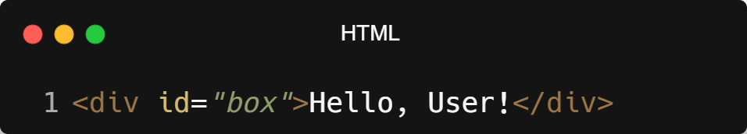
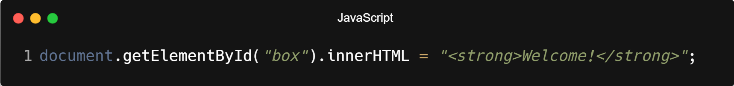
| .innerHTML
Example :

Slide 12

| .innerHTML
Output:
Before Adding .innerHTML
After Adding .innerHTML

Slide 13
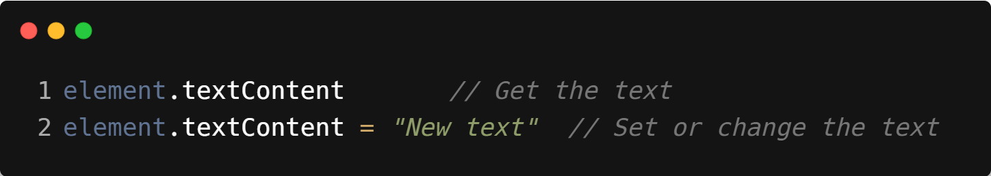
| .textContent
.textContent is a property in JavaScript that lets you get or change the text inside an HTML element.
It only affects plain text, not HTML tags.
Syntax :

Slide 14
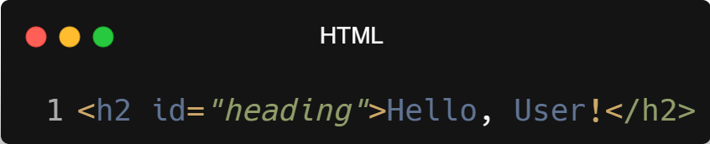
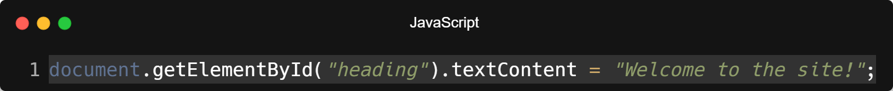
| .textContent
Example :

Slide 15


| .textContent
Output:
Before Adding .textContent
After Adding .textContent

Slide 16
| .textContent vs .innerText vs .innerHTML
Feature | .innerText | .textContent | .innerHTML
What it changes/gets | Only visible text | All text (even hidden ones) | Text plus HTML tags
Includes hidden elements? | No (ignores display: none) | Yes | Yes
Renders HTML tags? | No | No | Yes (interprets HTML)
Respects styling/layout? | Yes (includes line breaks etc.) | No | Yes
Use case | When you care about what's visible | When you want the raw text | When you want to insert or get HTML code
Performance | Slower (calculates layout) | Faster (reads DOM directly) | Medium (renders HTML)

Slide 17

| Coding Questions
1. Simple Click Event
Task :
Given the HTML below, write a script that adds a 'click' event listener to the button. When the button is clicked, the text inside the paragraph (<p>) should change to "Button was clicked!".

Slide 18
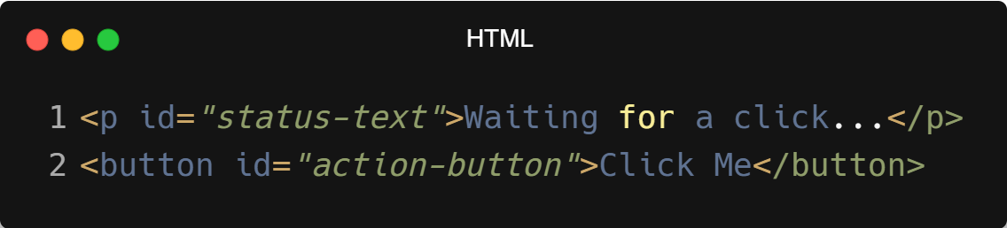
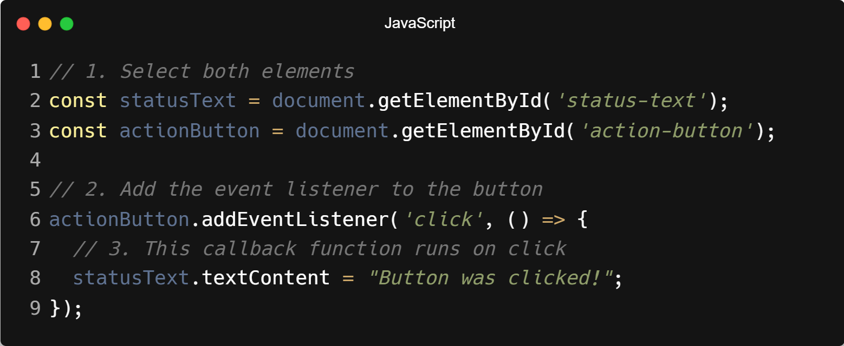
| Coding Questions
Solution :

Slide 19
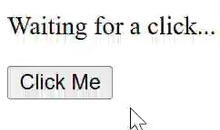
| Coding Questions
Output :

Slide 20
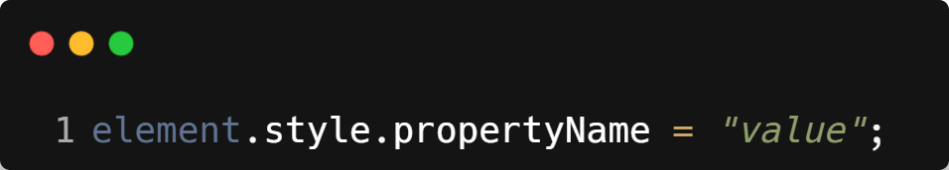
| .style
.style is a property in JavaScript that allows you to change the inline CSS styles of an HTML element directly from your script.
Note: Use camelCase for multi-word CSS properties.
Example: background-color becomes backgroundColor.
Syntax :

Slide 21
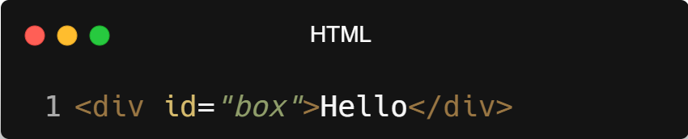
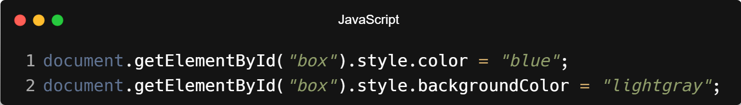
| .style
Example :

Slide 22

| .style
Output:
Before Adding .style
After Adding .style

Slide 23
| Coding Questions
1. Select and Style
Task :
Given the HTML below, write a JavaScript snippet to select the paragraph element with the ID main-text and change its text color to red and its font size to 24px.

Slide 24
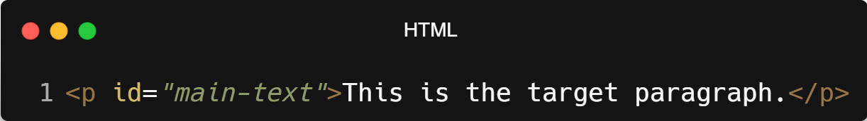
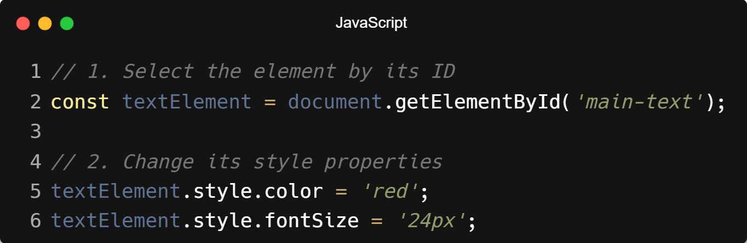
| Coding Questions
Solution :

Slide 25
| Coding Questions
Output :

Slide 26
| Creating and Removing Elements
Creating elements means generating new items (like text, boxes, images, etc.) to be added to a web page or application interface.
Removing elements means deleting or taking out existing items from a web page so they are no longer visible or part of the layout.
Some Common Methods:
.createElement();
.appendChild();
.removeElement();

Slide 27
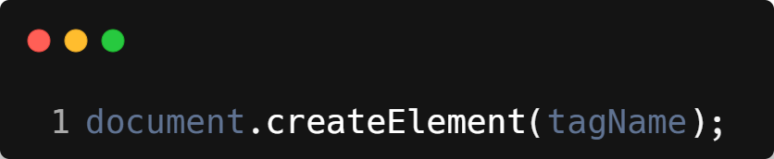
| .createElement()
document.createElement() is a JavaScript method used to create a new HTML element (like <div>, <p>, <button>, etc.) in memory.
It doesn’t appear on the page until you add it using a method like .appendChild().
Syntax :
tagName: A string representing the HTML tag you want to create (e.g., 'div', 'p', 'img').
Returns: A new DOM element (but not yet on the page).

Slide 28
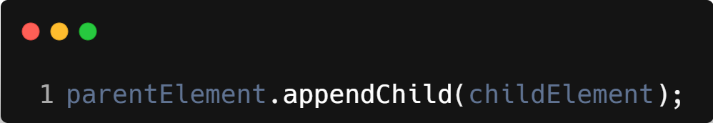
| .appendChild()
.appendChild() is a DOM method used to add an element as the last child inside a parent element.
It places the new element on the actual web page (if it was created using .createElement() or already exists).
Syntax :
parentElement: The existing DOM element where you want to insert something.
childElement: The element you want to insert at the end of parentElement.

Slide 29
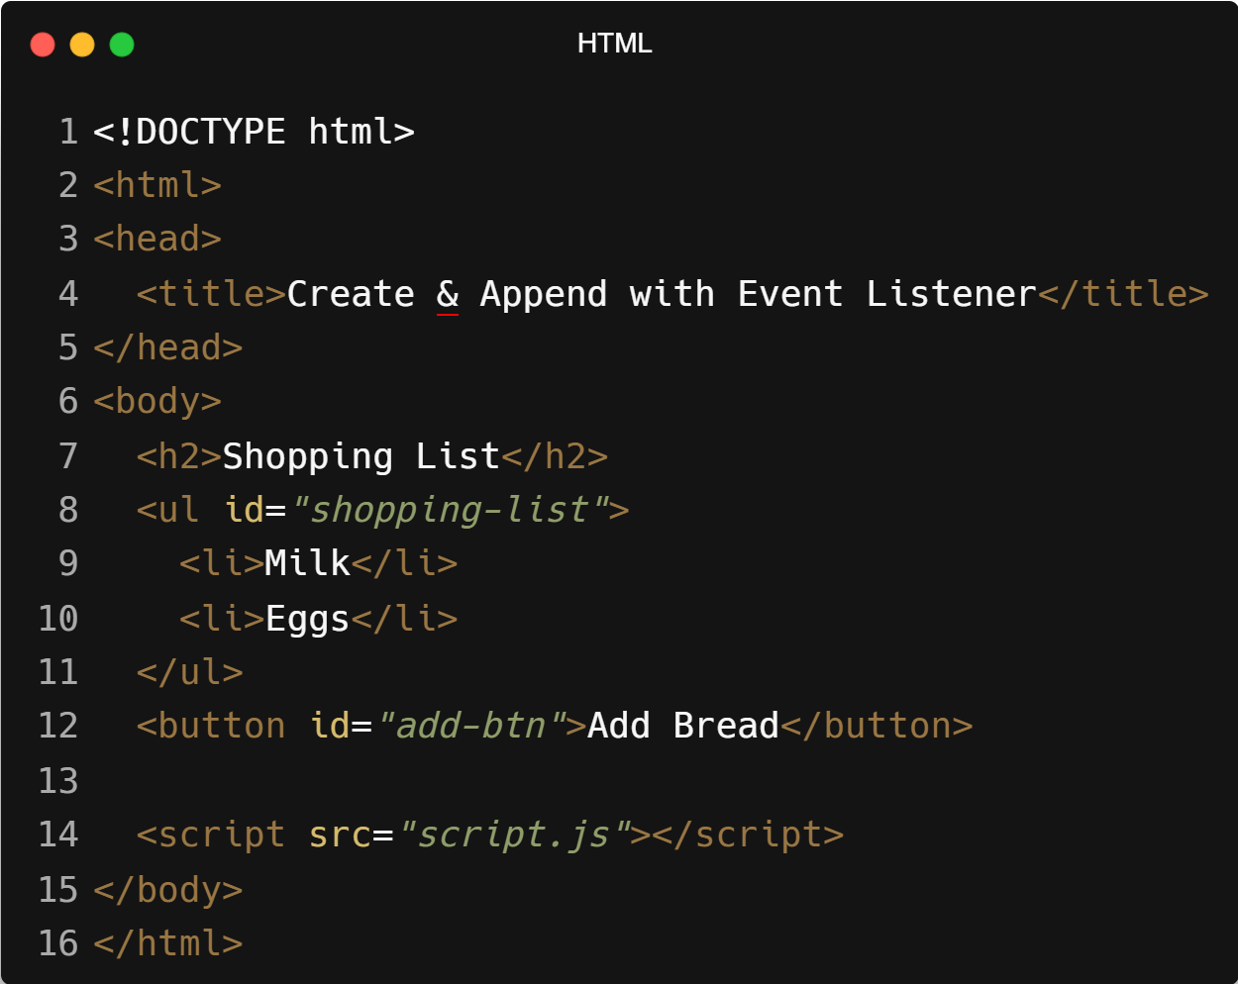
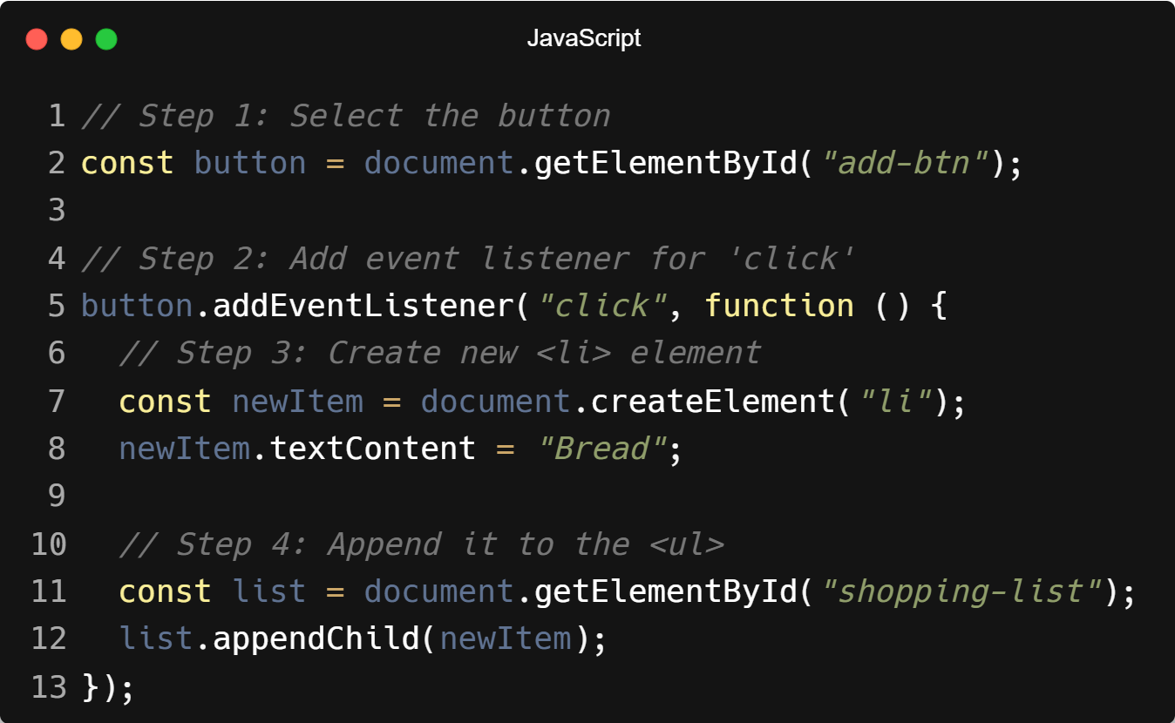
| Example: .createElement() and .appendChild()

Slide 30
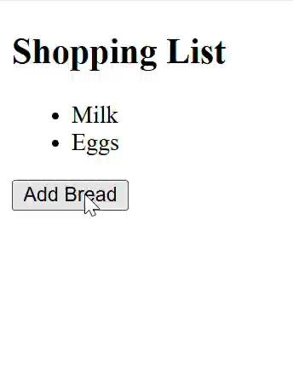
| Output : .createElement() and .appendChild()

Slide 31
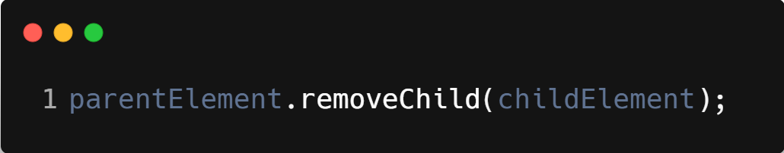
| .removeChild()
.removeChild() is a DOM method used to remove a child element from its parent in the HTML document.
You must call it on the parent element and pass the child element you want to remove.
Syntax :
parentElement: The DOM element that contains the child.
childElement: The DOM element you want to remove.

Slide 32
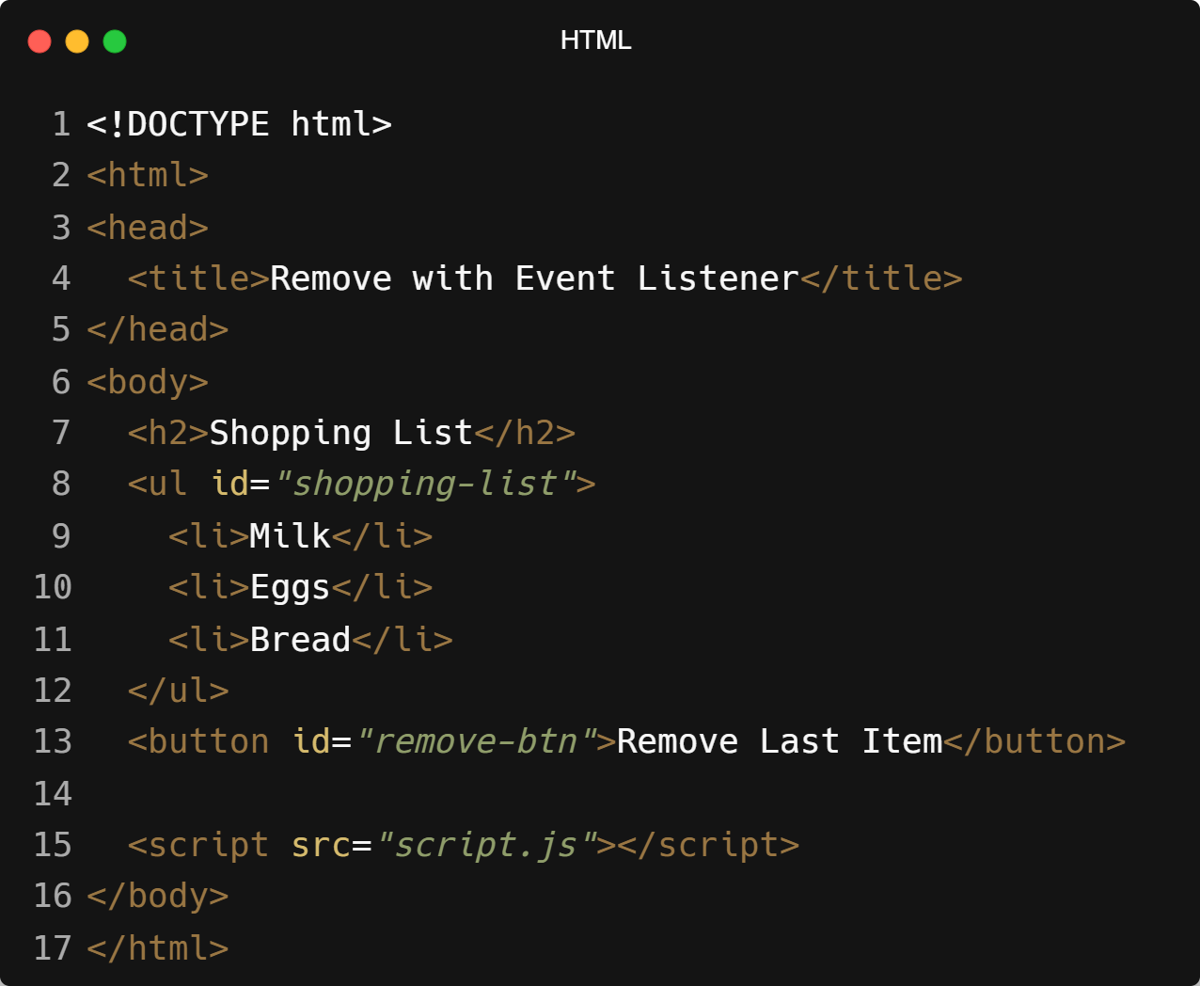
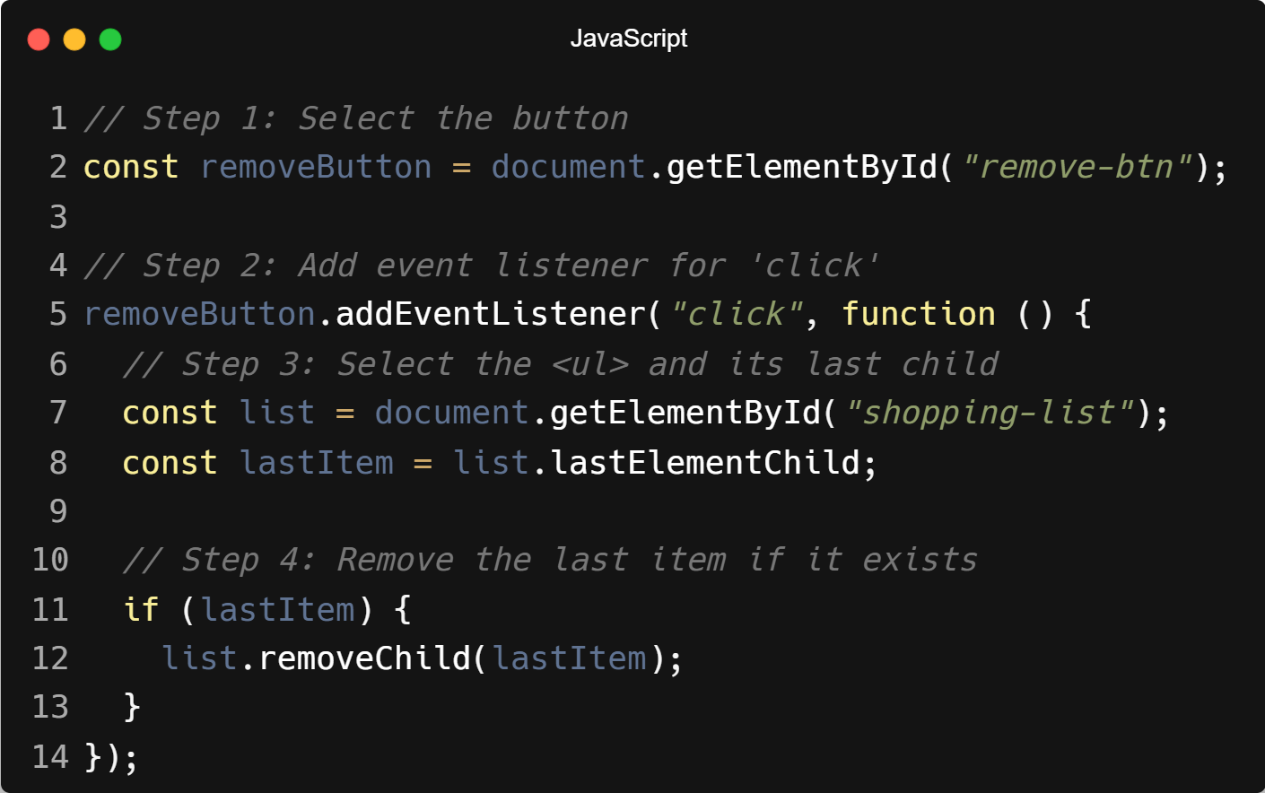
| Example: .removeChild()

Slide 33
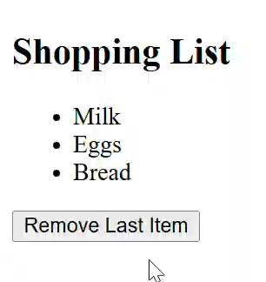
| Output : .removeChild()

Slide 34
| Introduction to classList
classList is a property of DOM elements
Used to manage CSS classes dynamically
Allows adding, removing, and toggling classes
Keeps CSS and JavaScript separate
Method | Purpose
add() | Adds class
remove() | Removes class
toggle() | Adds/removes class
contains() | Checks class

Slide 35
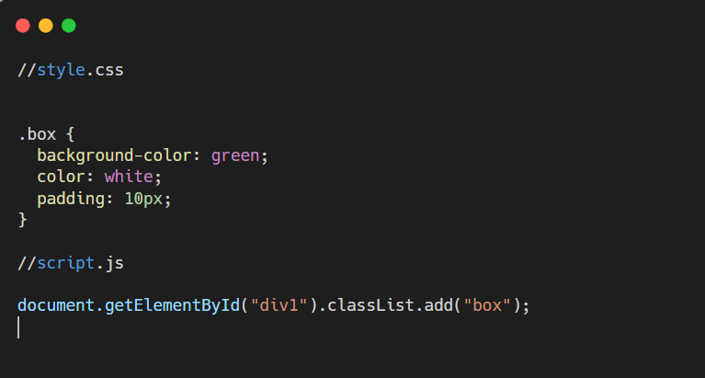
| classList.add()

Slide 36
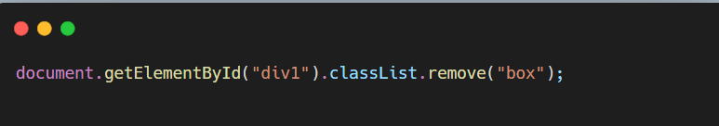
| classList.remove()
Removes all styles applied by the class

Slide 37
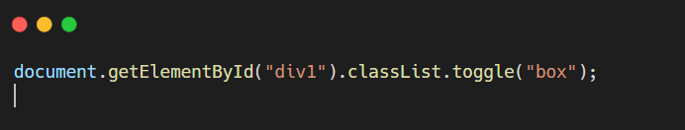
| classList.toggle()
How it works:
If class exists → removes it
If class does not exist → adds it

Slide 38
| Check Your Understanding
Question : Which property should you use to change the text inside a <p> tag without
interpreting any HTML tags that might be in the string?
Options : a) innerHTML
b) textContent
c) style
d) value
Answer : b) textContent
Explanation:
textContent (and innerText) treats all content as plain text. innerHTML, on the other hand, will parse and render any HTML tags within the string, which can be a security risk if the content is from a user

Slide 39
| References
MDN Web Docs : Comprehensive and official documentation for JS.
🔗https://developer.mozilla.org/en-US/docs/Web/JavaScript
W3Schools – JS Tutorial : Beginner-friendly JS tutorials with examples and interactive editors.
🔗 https://www.w3schools.com/js/
JavaScript.info - A comprehensive tutorial-style website that covers core JavaScript concepts in depth.
🔗https://javascript.info/

Slide 40
Thanks
For
Watching
Course - Web Development - II
welcome@krmangalam.edu.in
Sohna Road,Gurugram,Haryana 122103

